Slide 1
REFERENCING & REPORTING
Computing – Faculty of Business, Law and Digital
martin.reid@solent.ac.uk

Slide 2
The idiots guide to Citation, Referencing & Report Writing

Slide 3
Students
X
The idiots guide to Citation, Referencing & Report Writing

Slide 4
Research
Notes:
Before you can reference you will need to research

Slide 5
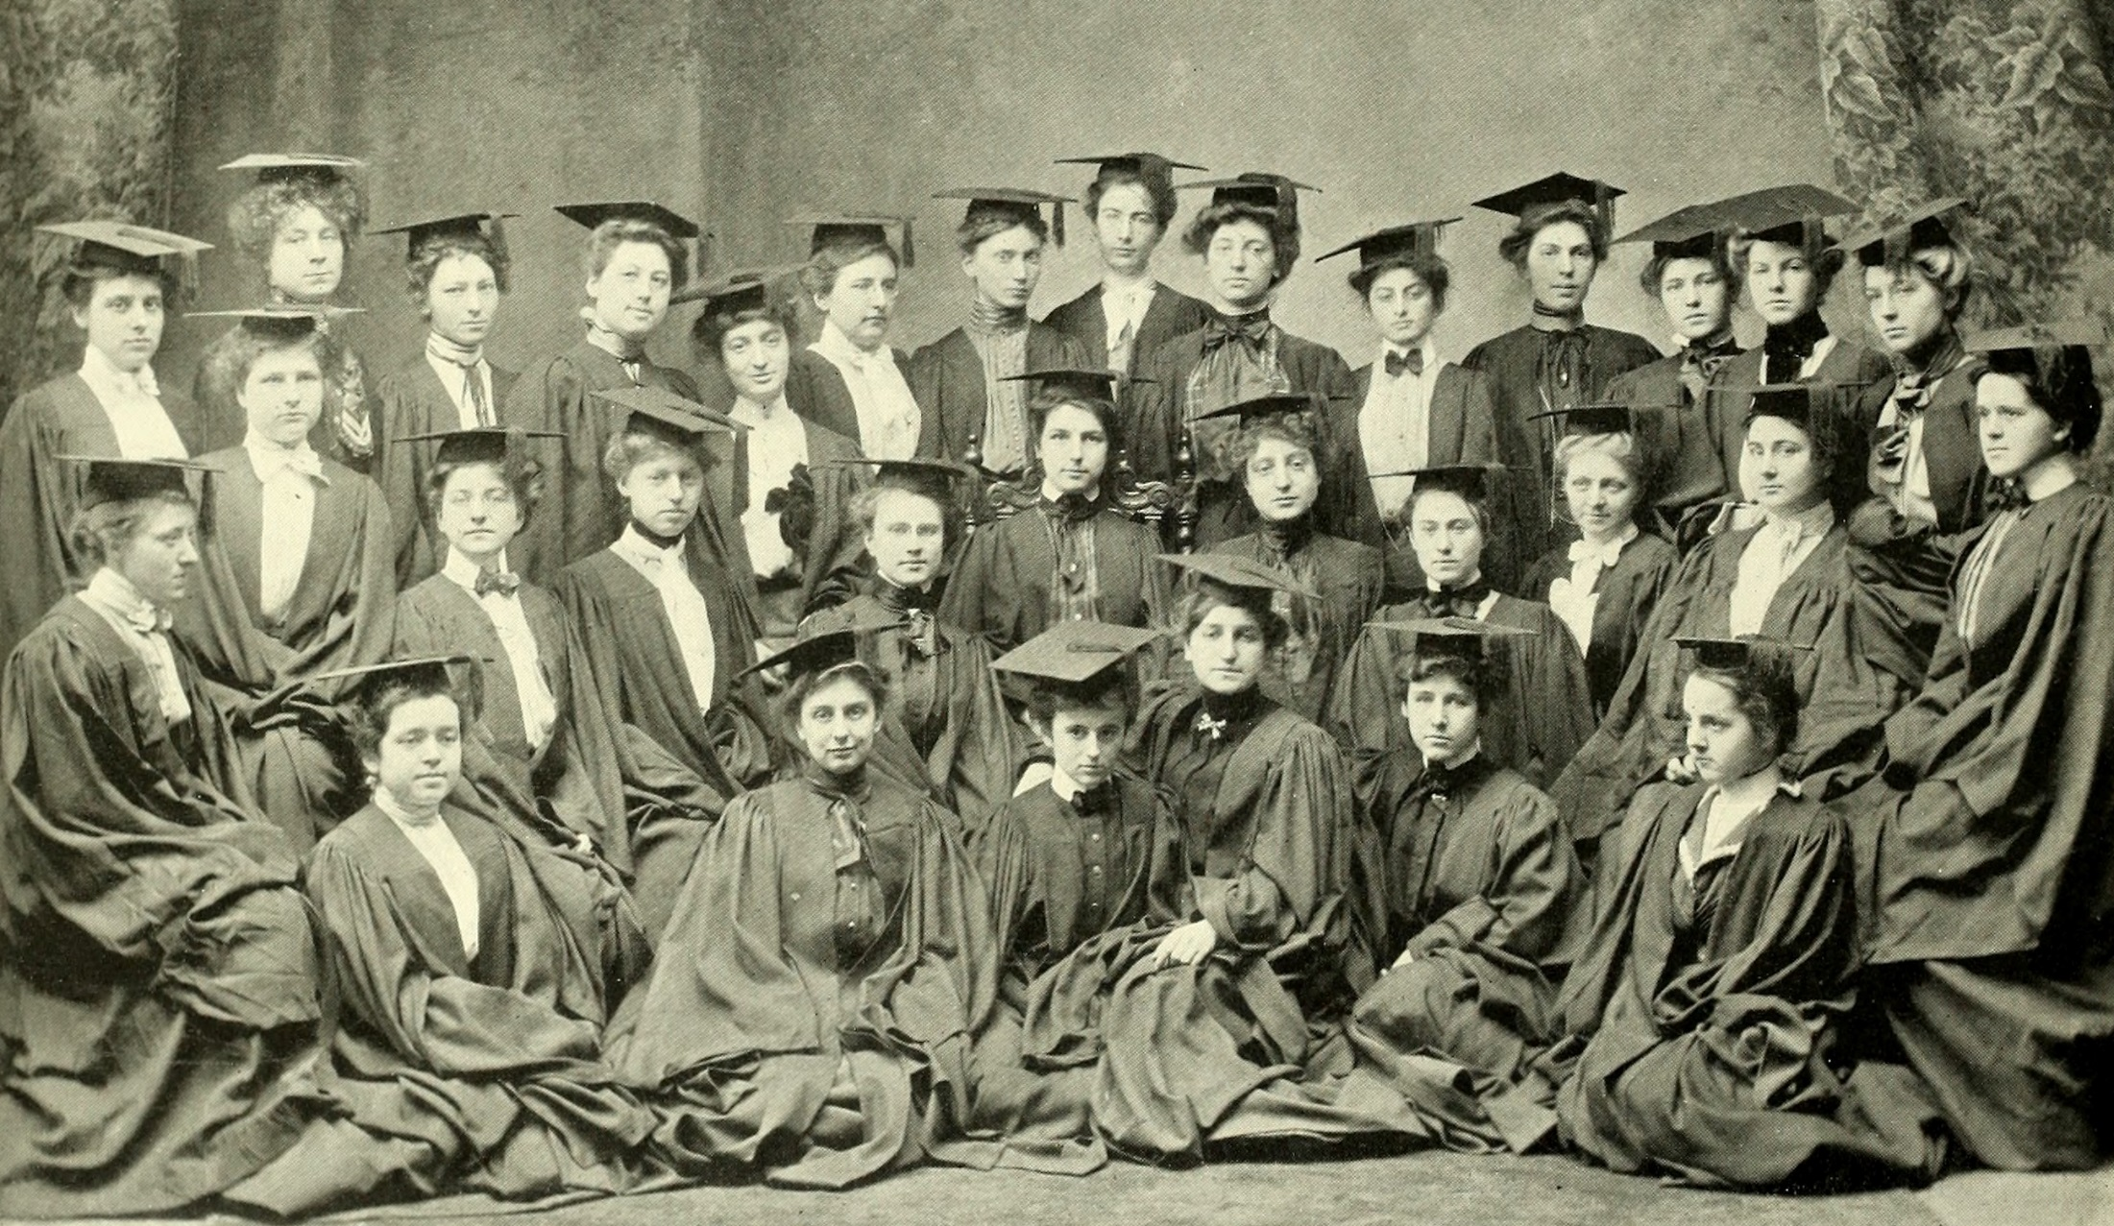
"Image from page 111 of "Mortarboard" (1901)" flickr photo by Internet Archive Book Images https://flickr.com/photos/internetarchivebookimages/14596812858 shared with no copyright restriction (Flickr Commons)
Notes:
Why do we need to reference first it is academic integrity

Slide 6
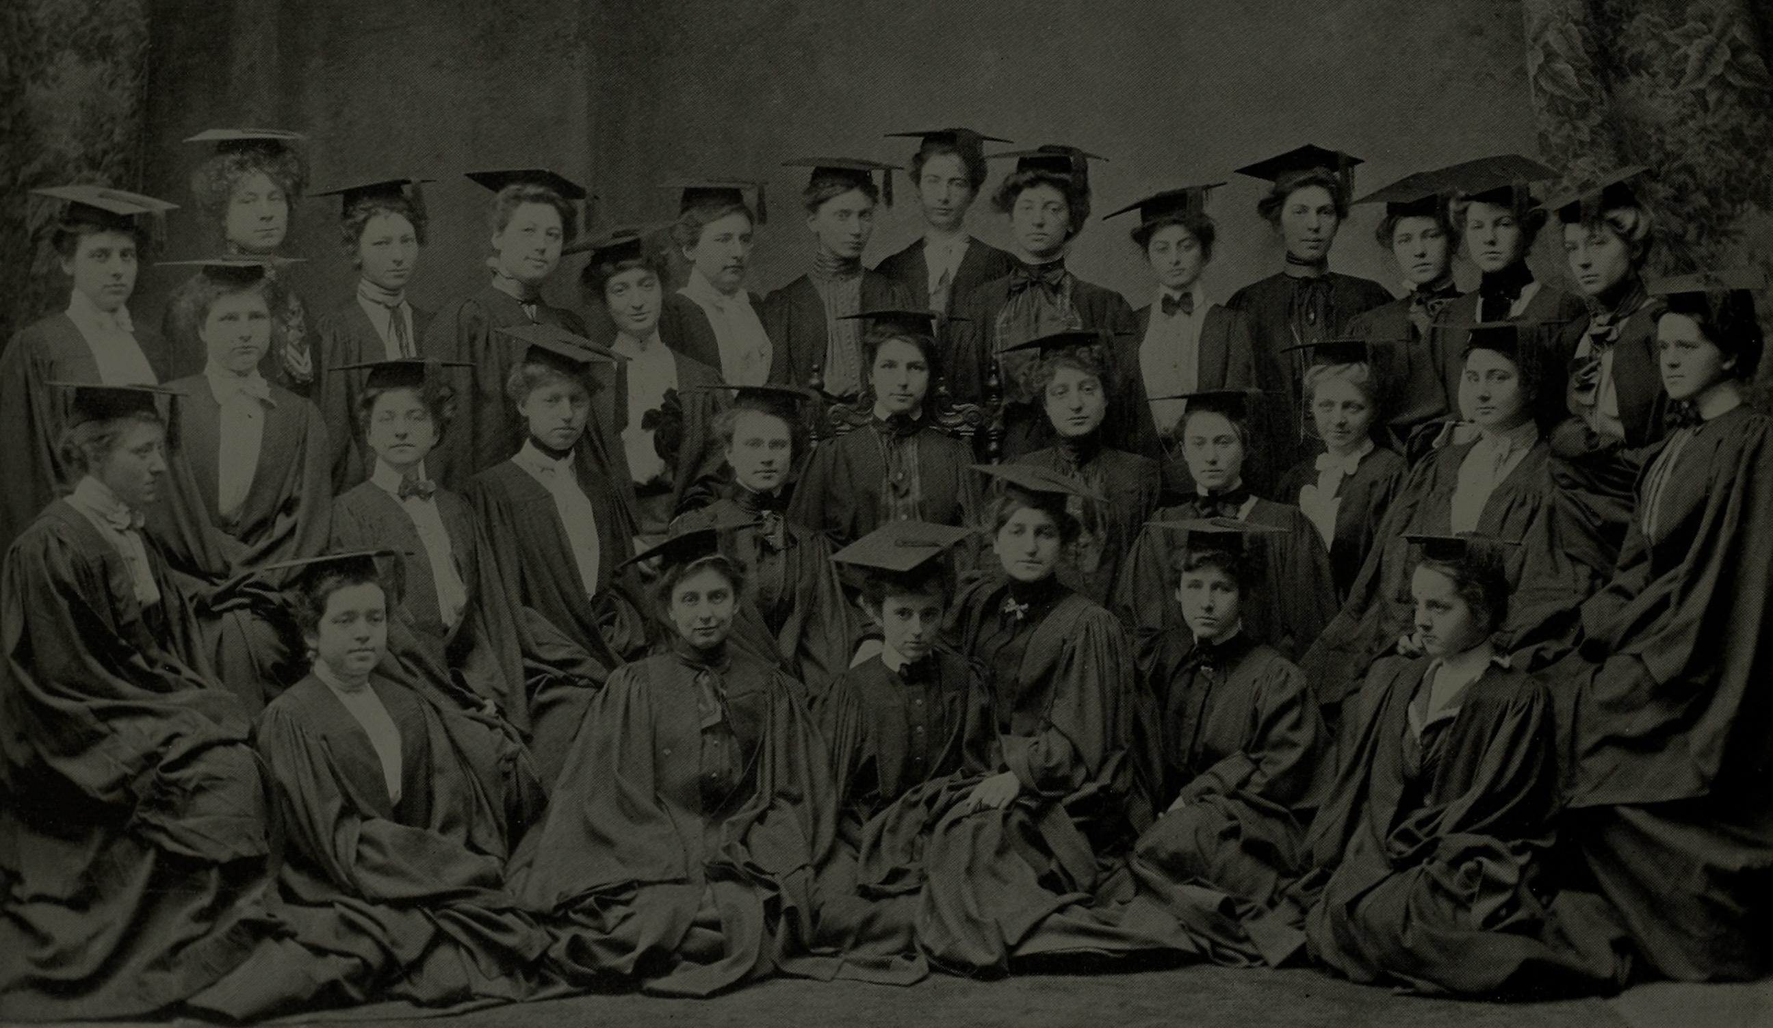
Academic Integrity
Notes:
Why do we need to reference first it is academic integrity

Slide 7

Notes:
And avoid passing off other peoples work as your own as this would be described as plagiarism

Slide 8
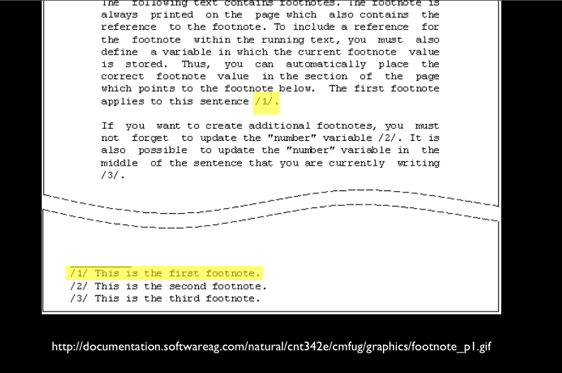
Notes:
There are a number of types of referencing systems such as footnote system

Slide 9
The in-text citation:
(Airey 2010)
Corresponding reference list item:
AIREY, D., 2010. Logo Design Love: A guide to Creating Iconic Brand Identities. Berkeley CA: New Riders.
Notes:
Example of Author date system
Author details (surname first) – use a corporate author/organisation if no individual is named
Year the material was published/created
Title details
Publication details – where and by whom a document was published (not always given for electronic material)

Slide 10

SSU Harvard Reference System
Notes:
Here at Solent we use the author date Harvard referencing system

Slide 11
(Airey 2010 p.10)
Notes:
InTEXT reference: second name date and page number in brackets

Slide 12
(Airey 2010 p.10)

Slide 13
(Airey 2010 p.10)

Slide 14
(Airey 2010)

Slide 15
Airey, D., 2010 Logo Design
Love: A guide to Creating Iconic Brand Identities.
Berkeley CA: New Riders.
Notes:
The corresponding reference list item

Slide 16
Reference List
ALL sources used in the Report or Essay
Notes:
Reference list contains all the sources you have reference

Slide 17
Bibliography List
Sources used within research, but not directly referenced to.
Notes:
Reference list contains all the sources you have reference

Slide 18
In-text reference for a book with one author
(Stevens 1996)
Reference list item:
STEVENS, M., 1996 Presentation Skills.
London: Kogan Page

Slide 19
In-text reference for a book two authors:
(Stevens and Hatcher 1996)
Reference list item:
STEVENS, M. and C. HATCHER 1996 Presentation Skills. London: Kogan Page

Slide 20
In-text reference for a book with three author:
(Stevens, Smith and Hatcher 1996)
Reference list item:
STEVENS, M., A. SMITH and C. HATHER 1996 Presentation Skills. London: Kogan Page

Slide 21
In-text reference for a book three plus authors:
(Stevens et al 1996)
Reference list item:
STEVENS, M. et al 1996 Presentation Skills. London: Kogan Page

Slide 22
Secondary Sources
Shuell (cited in Biggs and Tang 2011, p.97)
Or
(Shuell cited in Biggs and Tang 2011, p.97)

Slide 23
Website:
(Stevens 1996)
Reference list item:
STEVENS, N., 1996. Presentation Skills [viewed 12 May 2016] Available from http://stevens.com/presentation-skills

Slide 24
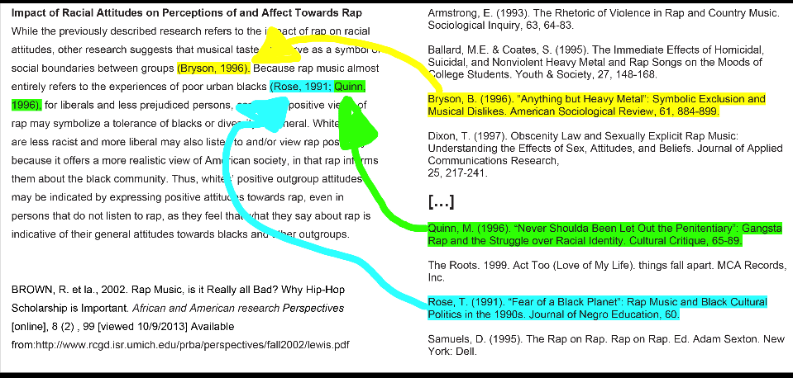
Notes:
Here is an example of InTEXT reference and and their corresponding reference list items. NOTE: Althought this example is Harvard referencing it does not use the exact same style of formatting we use here at Solent

Slide 25
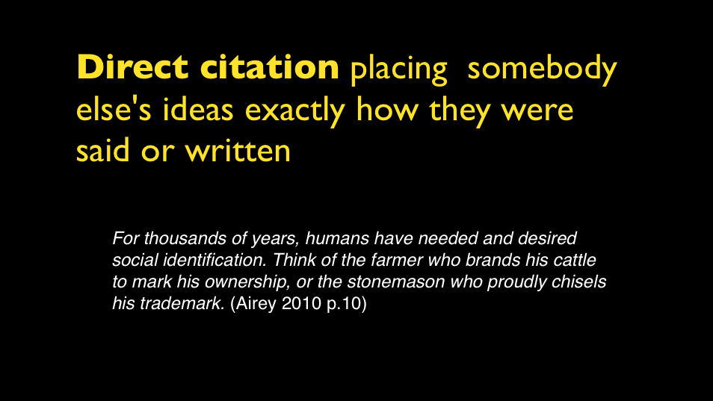

Slide 26
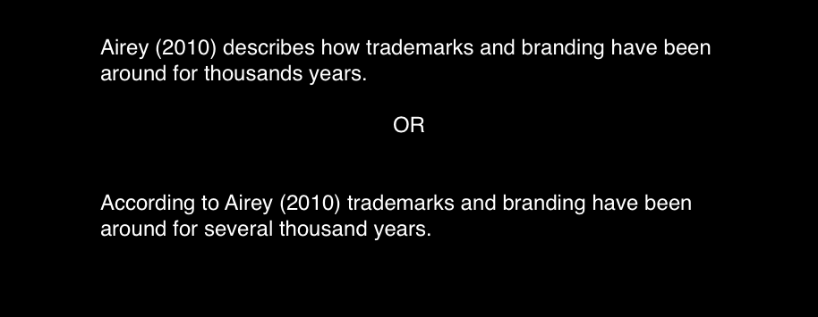

Slide 27
(Airey 2010a)
(Airey 2010b)
(Airey 2010c)
Notes:
If you have the same author but reference a number of their books add a, b, c etc

Slide 28
(Anon n.d)
Anonymous (author) and No Date (unknown date)

Slide 29
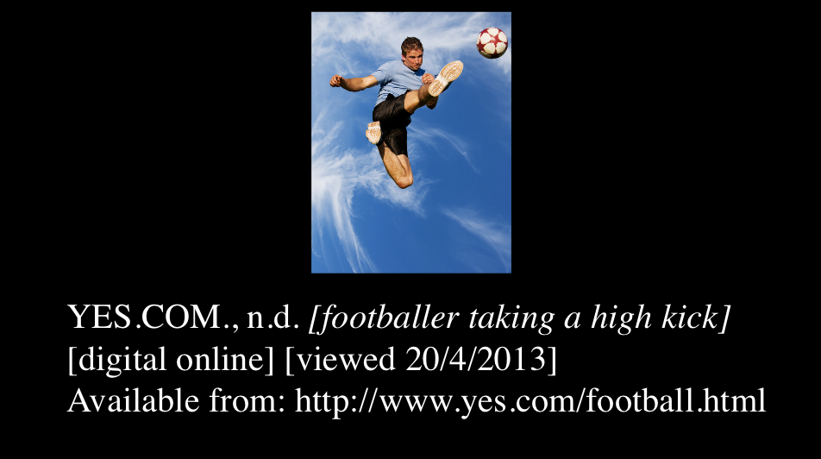
Notes:
If you have an image but do not have author or title describe the image and use the website as the author/ originator

Slide 30
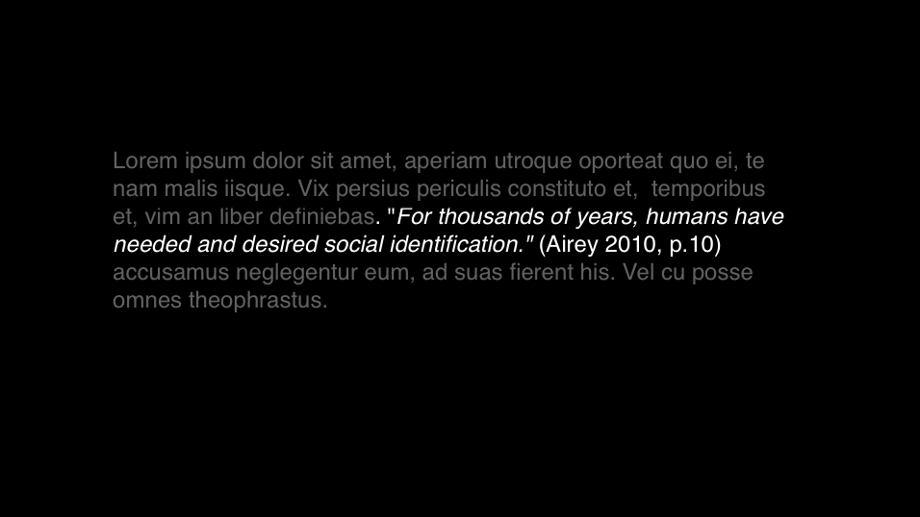
Notes:
Place short citations within the body of text

Slide 31
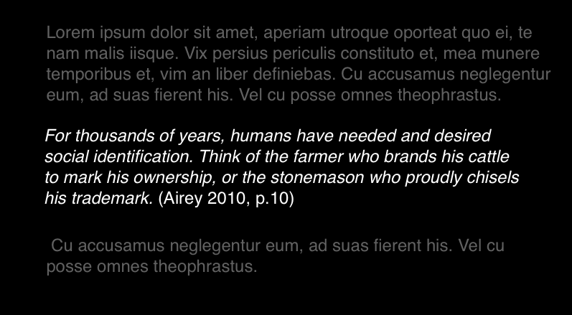
Notes:
Longer quotations as separate paragraphs make sure these are single line spacing you could place these in italics

Slide 32
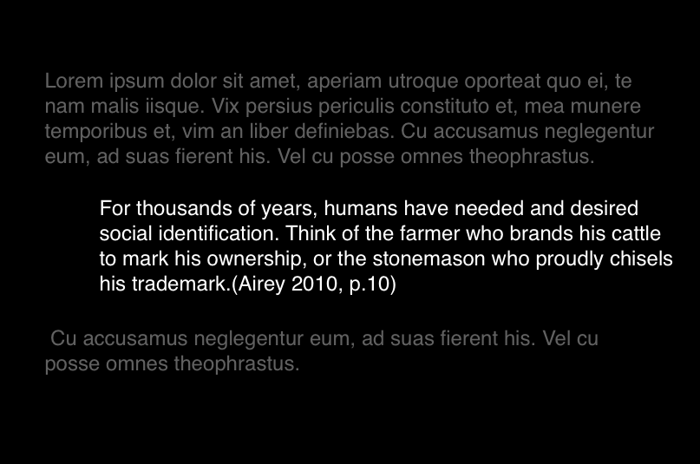
Notes:
Or you can indent

Slide 33
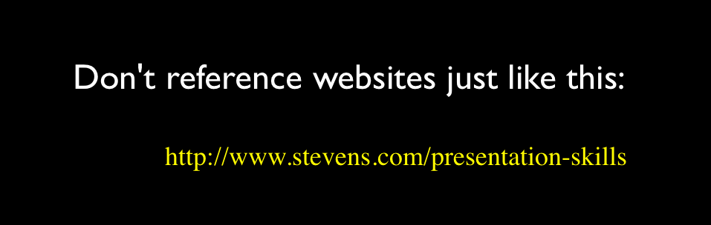
What to avoid

Slide 34
Useful abbreviations
Anon. anonymous
ed(s). editor(s) or edition
et al. and others (multiple authors)
n.d. date unknown
p. page
pp. pages
ibid. in the same book or article
op. cit. in the work already quoted

Slide 35
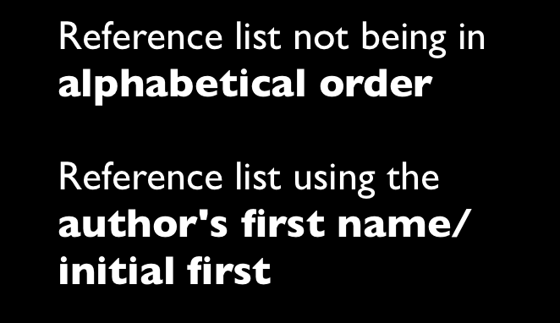
Common Mistakes

Slide 36

Notes:
But it can make

Slide 37

Notes:
or break an assignment

Slide 38
Academic Writing

Slide 39

Be objective in your thinking & writing

Slide 40
“Comic Sans is the best font in the world”
(Uncool 2013 p.50)
Notes:
Look at some ideas

Slide 41
“Comic Sans sucks”
(Cool 1998 p.51)
Notes:
Then look at other ideas they might challenge or conflict. - Balance the pros & cons

Slide 42

Notes:
Words to use when presenting other peoples ideas

Slide 43
Suggests…
Argues…
States…
Believes…
Concludes…
Proposes…
Expresses….
Holds the view that…
Draws attention to…
Describes…
Describes how…
Refers to…
Draws attention to…
Describes…
Describes how…
Refers to…
Takes the stand that…
Emphasises…
Stresses…
There is a view…
There is a theory…
There is an argument…
There is an idea…

Slide 44

Counter
-arguments
Notes:
Words to use to set out counterarguments

Slide 45
…Conflicts…
…Contrasts…
… Not accepted by…
..has been challenged by…
…on the other hand
however…
…an alternative view is…
…suggest the opposite…
…conflicting view is expressed by…

Slide 46
This conflicts with the view of Smith (2010) that…
Notes:
This is how it could look in the flow of your report,

Slide 47
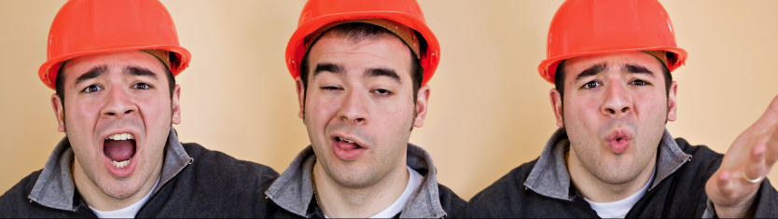
I said this…
I said that…
I think my project is really good…
Notes:
Avoid using “I”

Slide 48
When writing a academic
Report/Essay avoid using “I”
(Talking about yourself in first person)
The are exceptions, such as when writing about personal reflection and development

Slide 49
The research… The design… The project… The approach…

Slide 50



Slide 51
PLAGIARISM

Slide 52

images: Rugby471 CC BY-SA 3.0

Slide 53
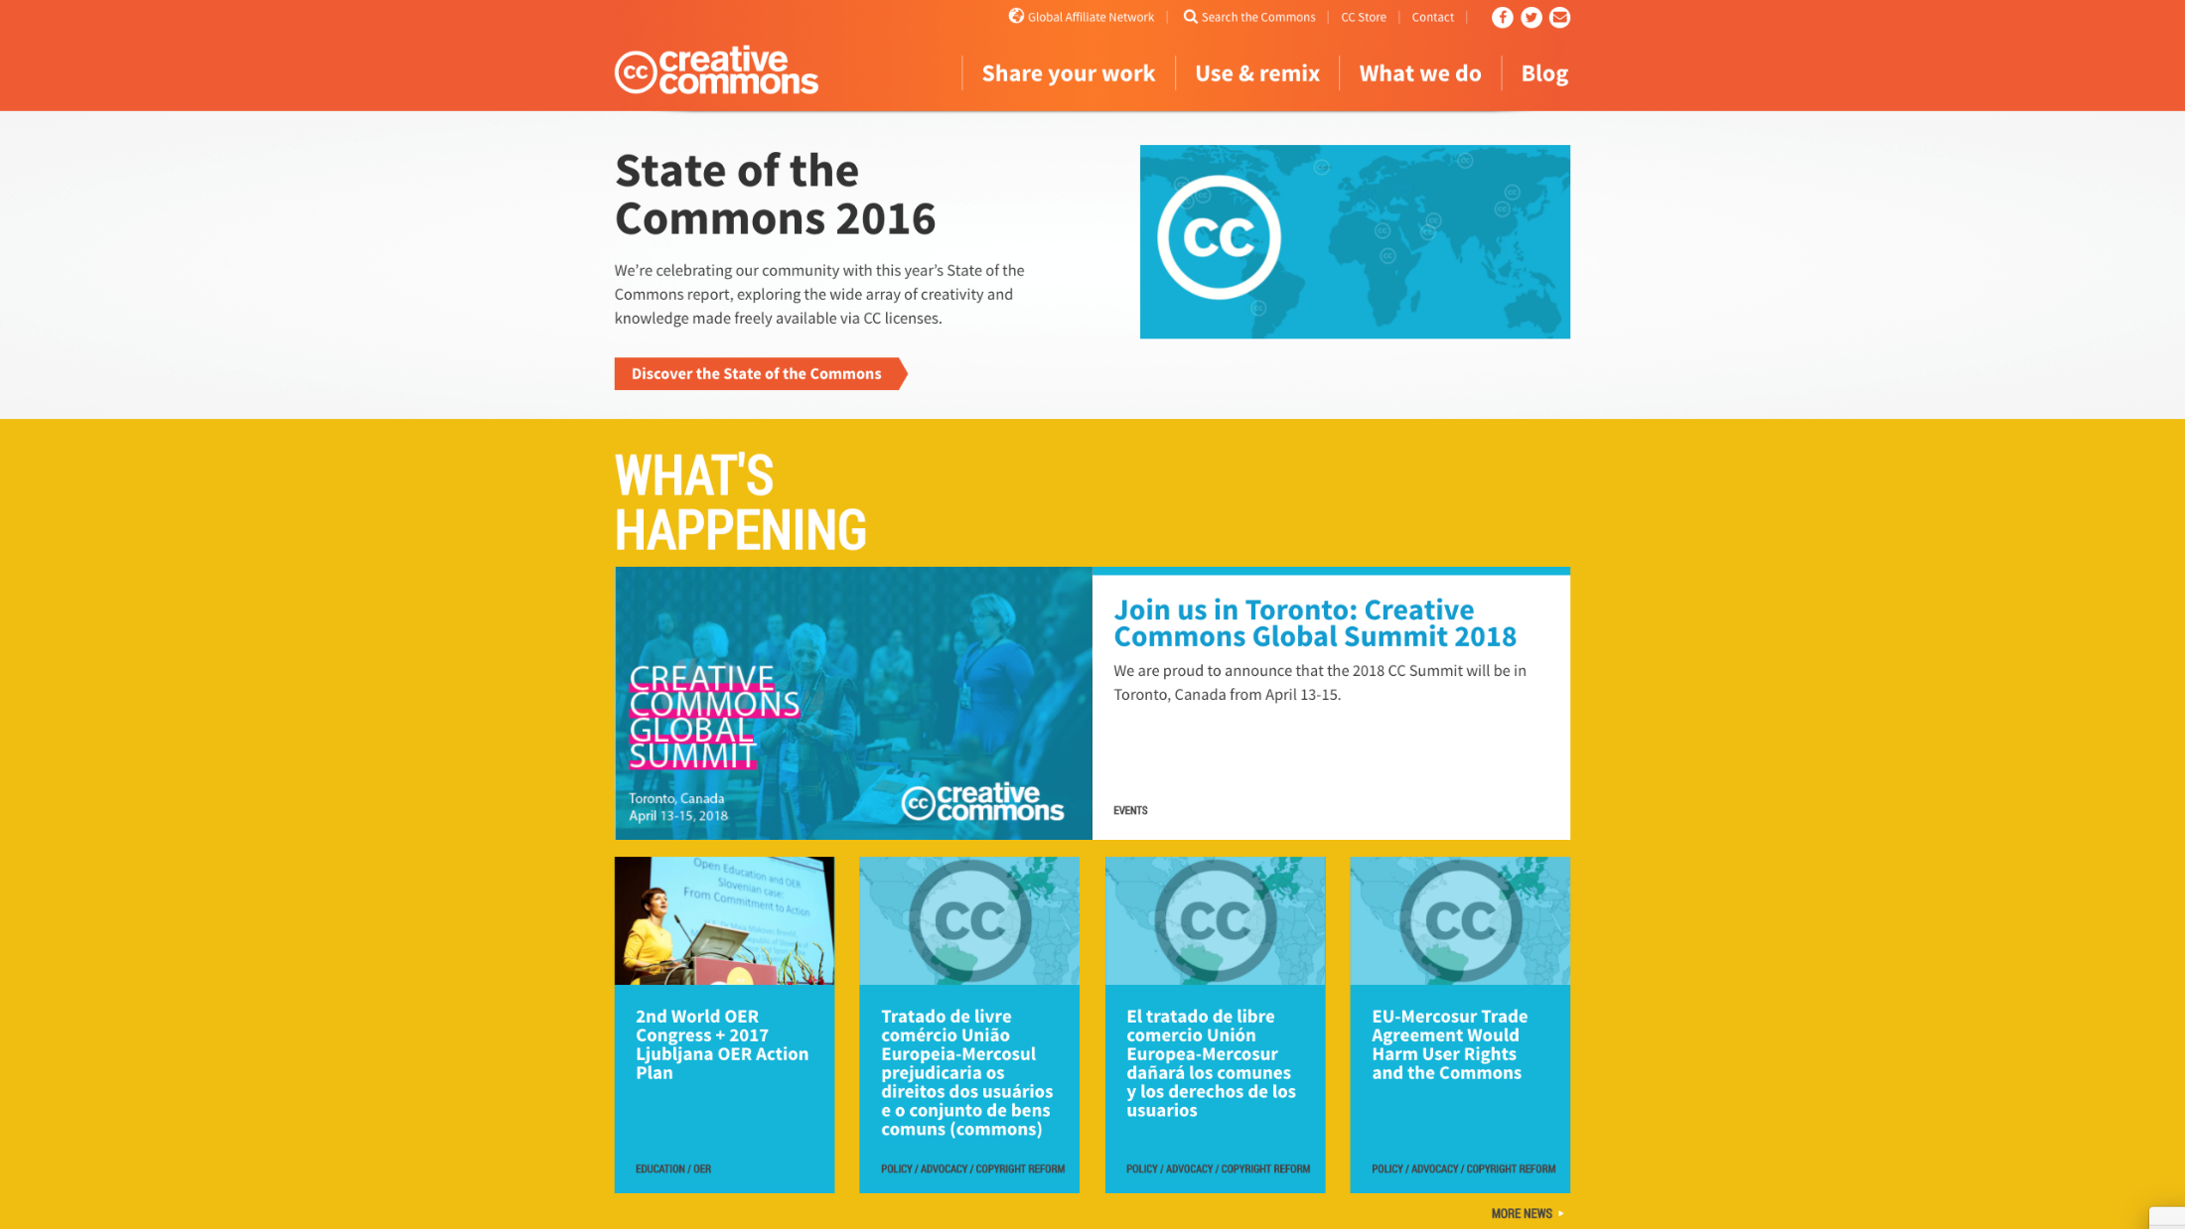
CREATIVECOMMONS. 2017. When we share, everyone wins [viewed Oct 8, 2017]. Available from: https://creativecommons.org/

Slide 54
The Block Quote
Either use sparingly or avoid using at all

Slide 55
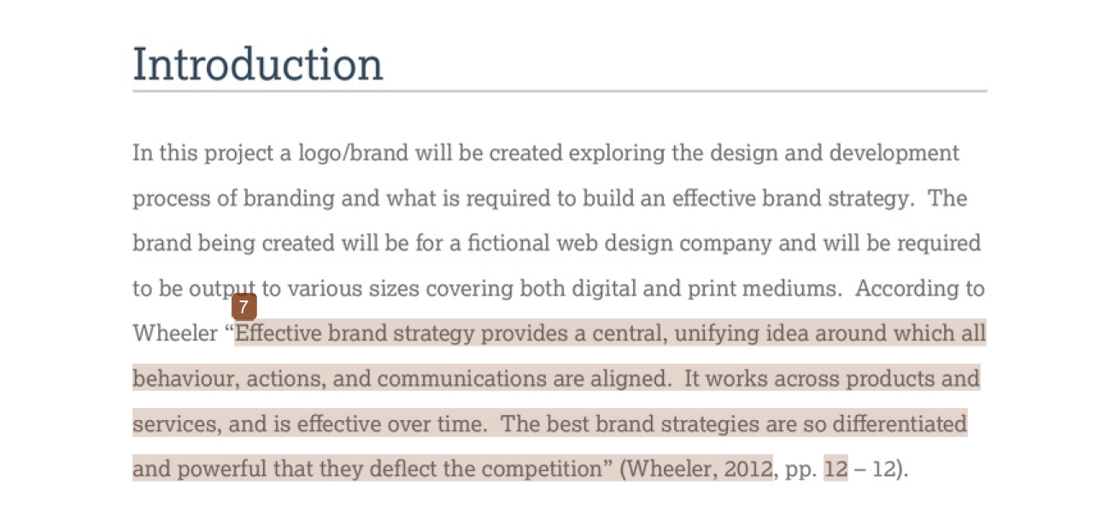

Slide 56
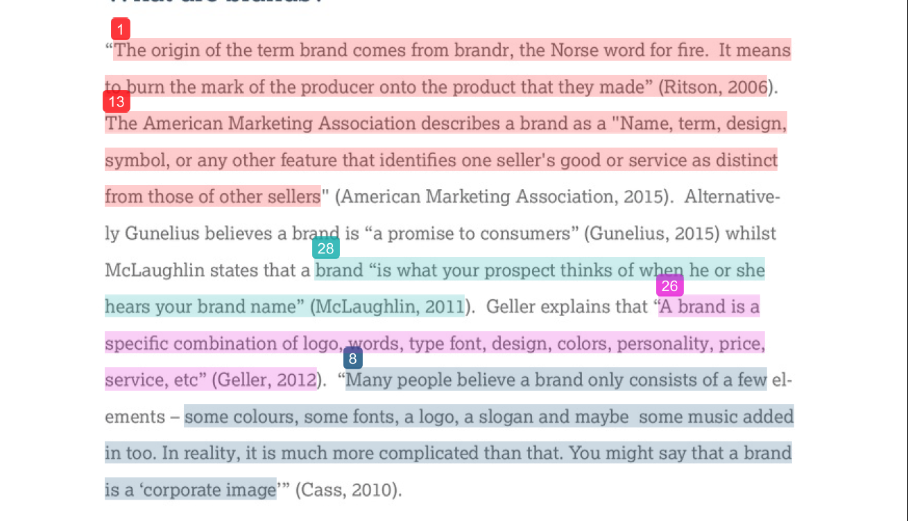

Slide 57
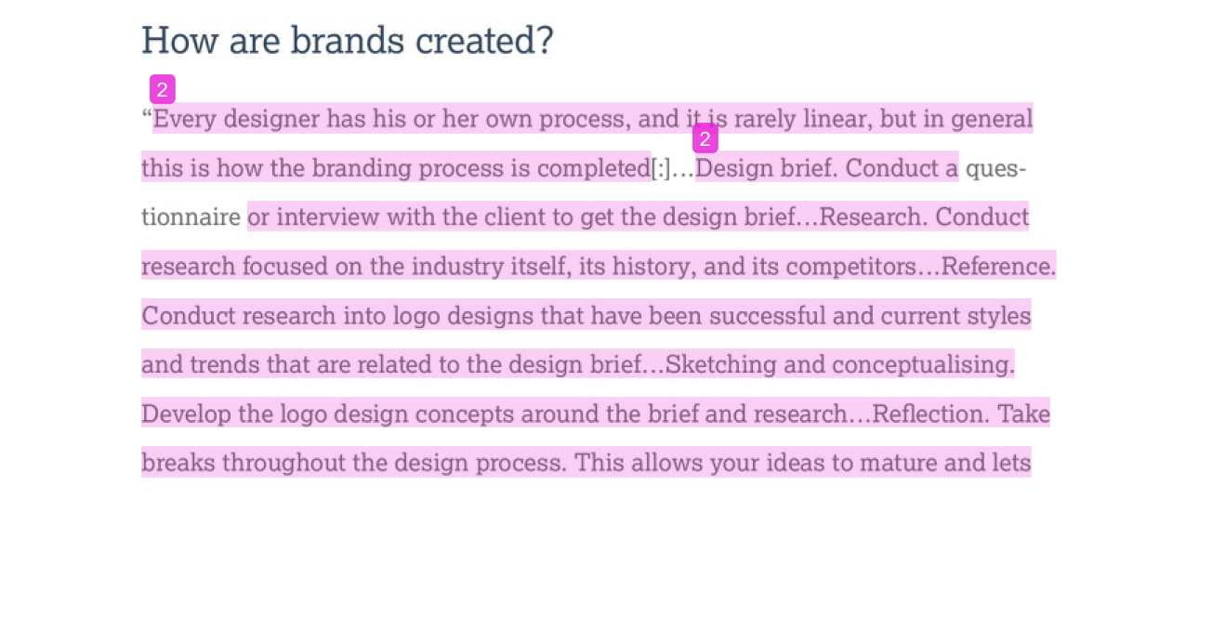

Slide 58
Paraphrasing

Slide 59
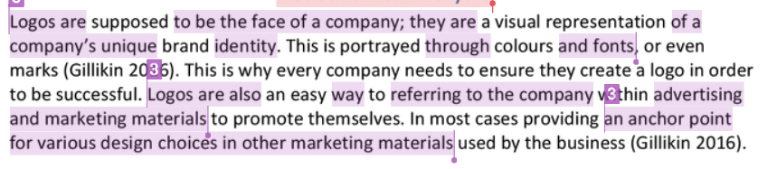
Paraphrasing is were the original work has been rearranged into a new pattern. In this example, it at first appears that the writing is all the student's “own” words, they even acknowledge the source, but there are no quotation marks.
The purple underlines show confusion between the student’s works and that of the original author.

Slide 60
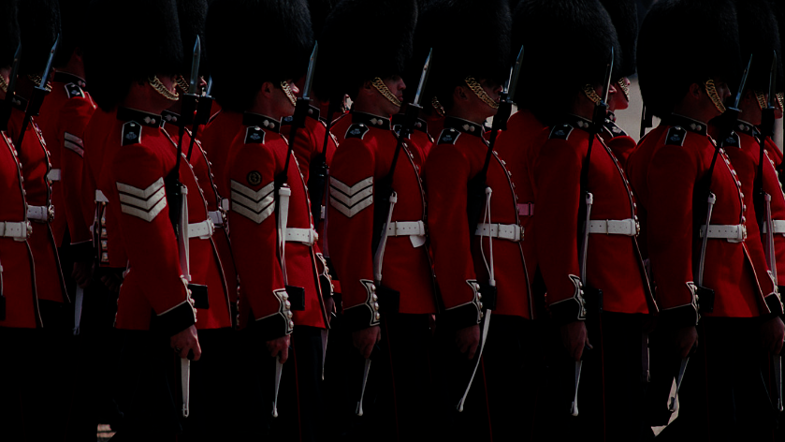
Keep your report structure uniformed
Notes:
No matter what style you may use for referencing and academic writing make sure you keep it uniformed and consistent throughout your reports

Slide 61
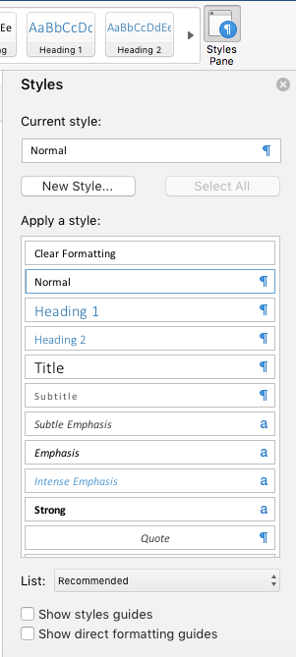
Make good use of word processing style sheets
Notes:
Make good use of word processing style sheets for titles subtitles quotes and citations and body text

Slide 62
Sign up

Slide 63

http://portal.solent.ac.uk/library/referencing/refworks.aspx
Notes:
Use tools such as Refworks.com to support you

Slide 64
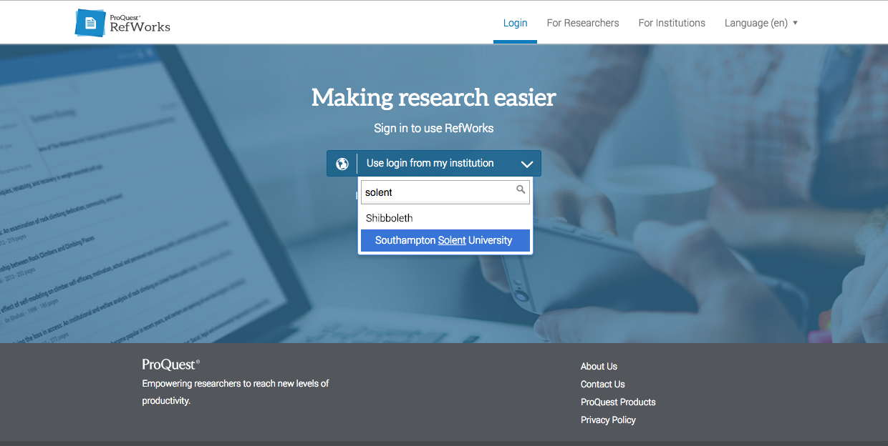

Slide 65
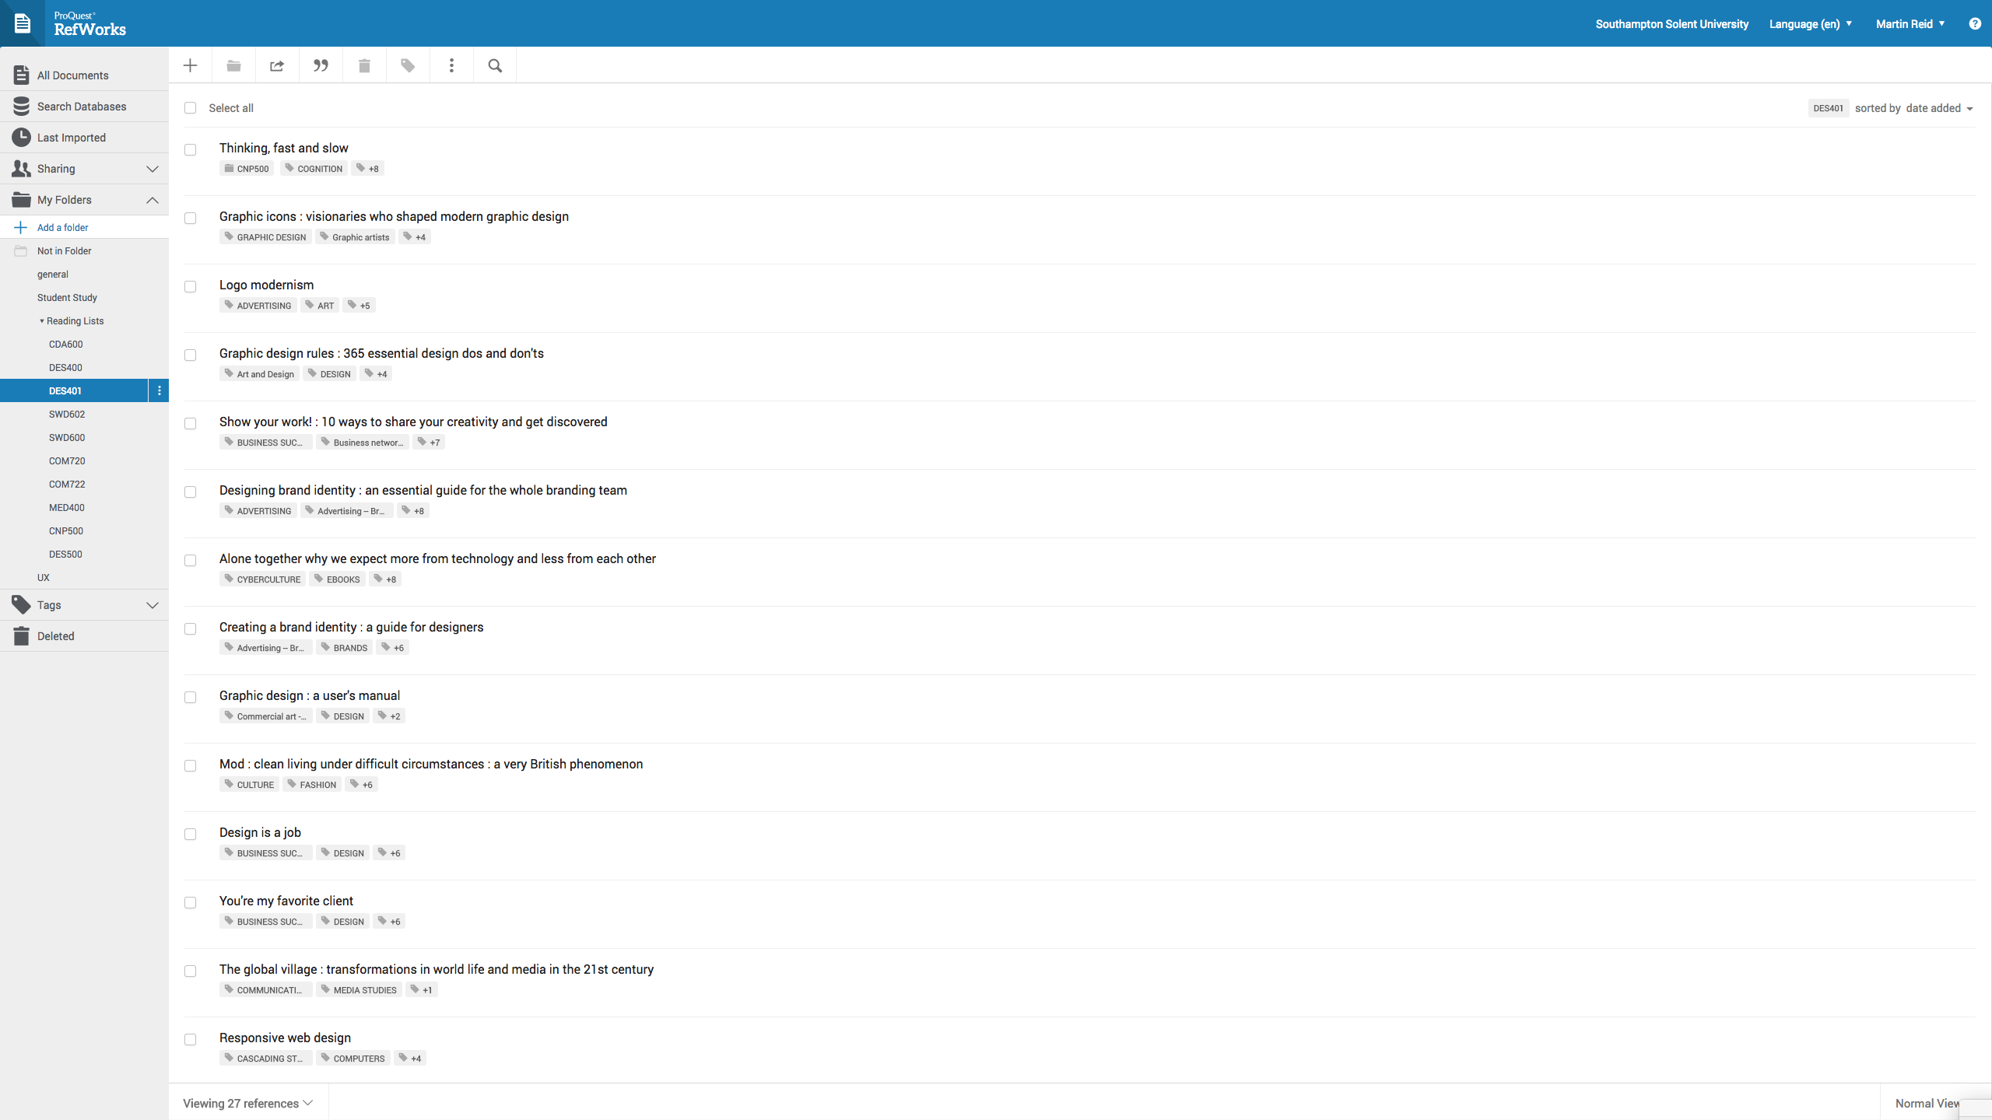

Slide 66
For more detail see: Referencing: the Harvard way
Available in print from the Mountbatten Library or on the portal:
http://portal.solent.ac.uk/library/help/factsheets/resources/referencing-harvard.pdf

Slide 67
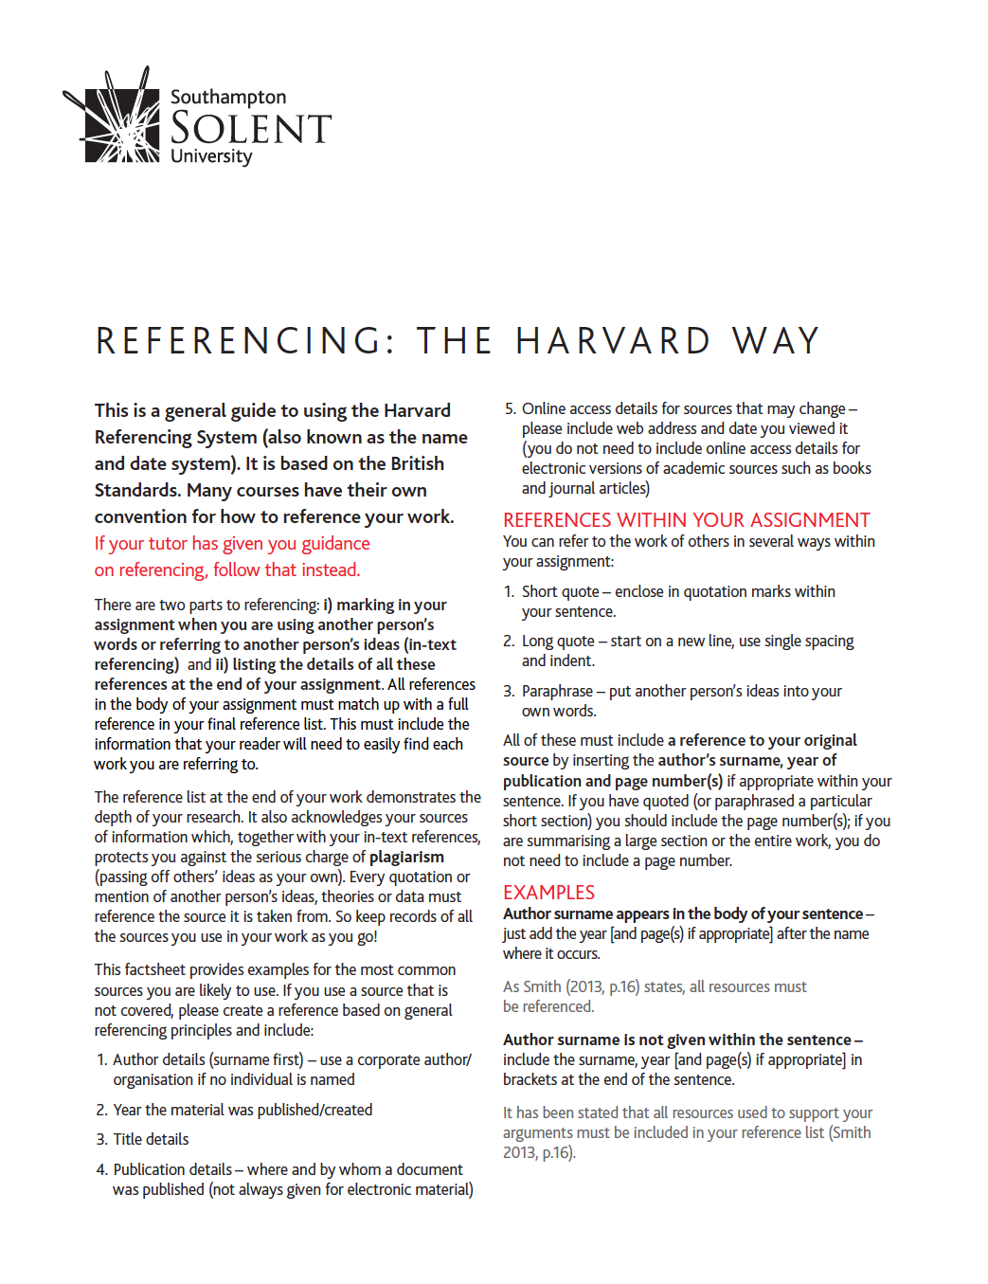

Slide 68
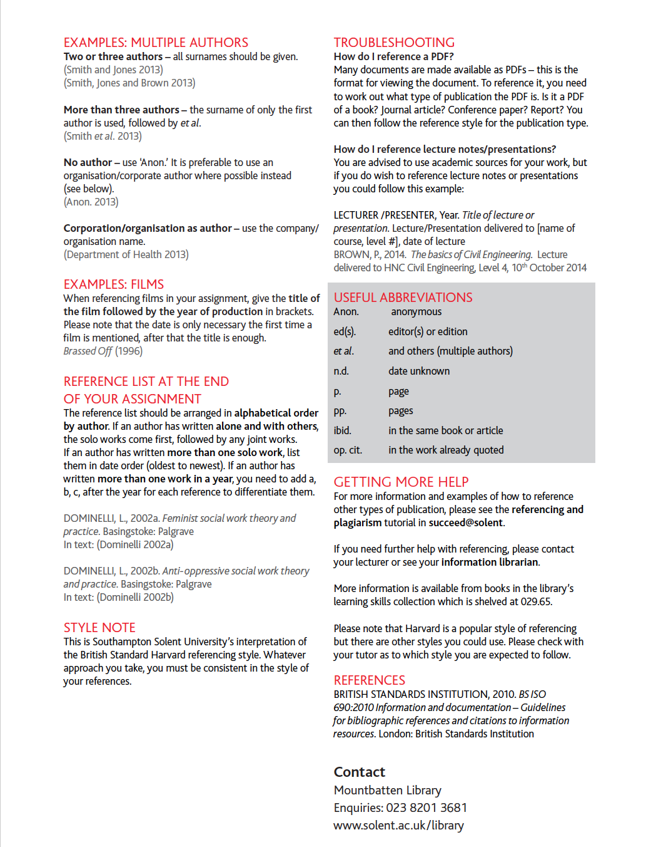

Slide 69
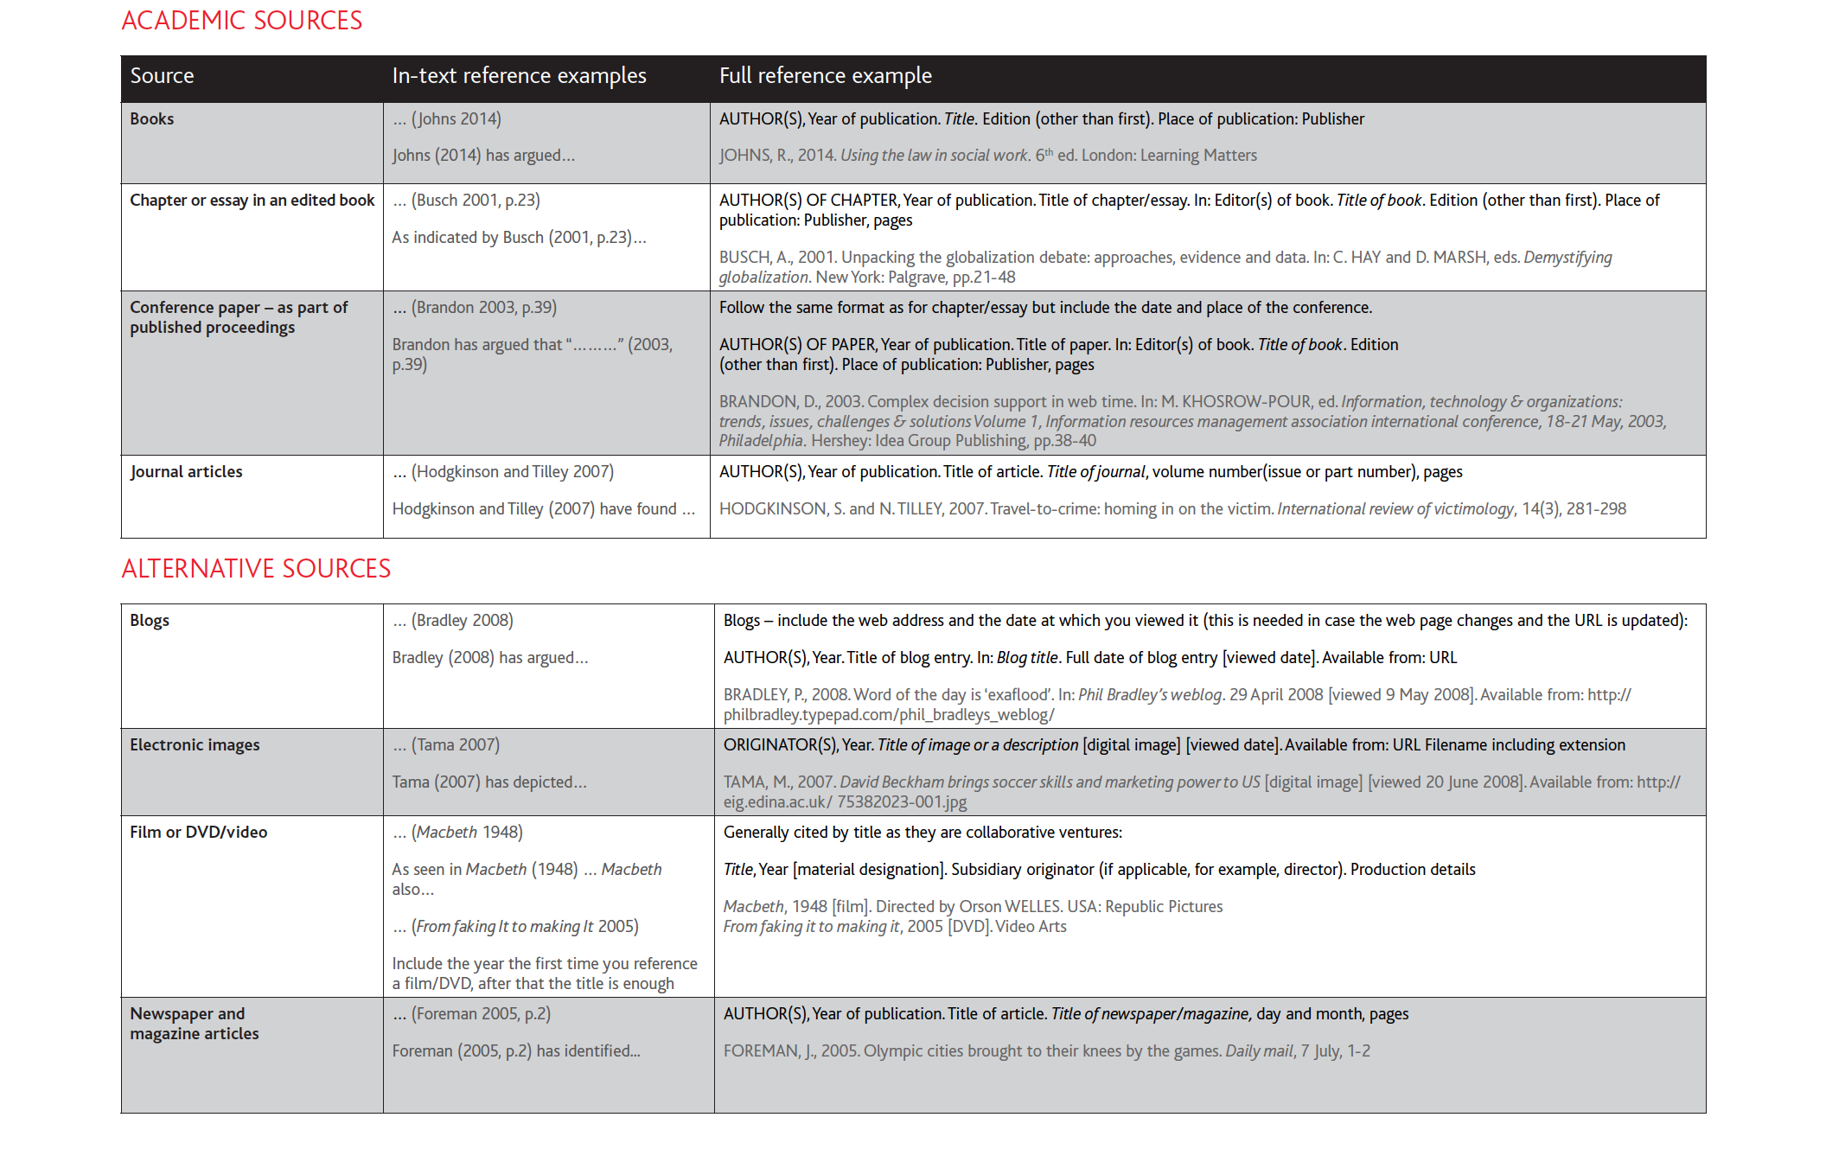

Slide 70
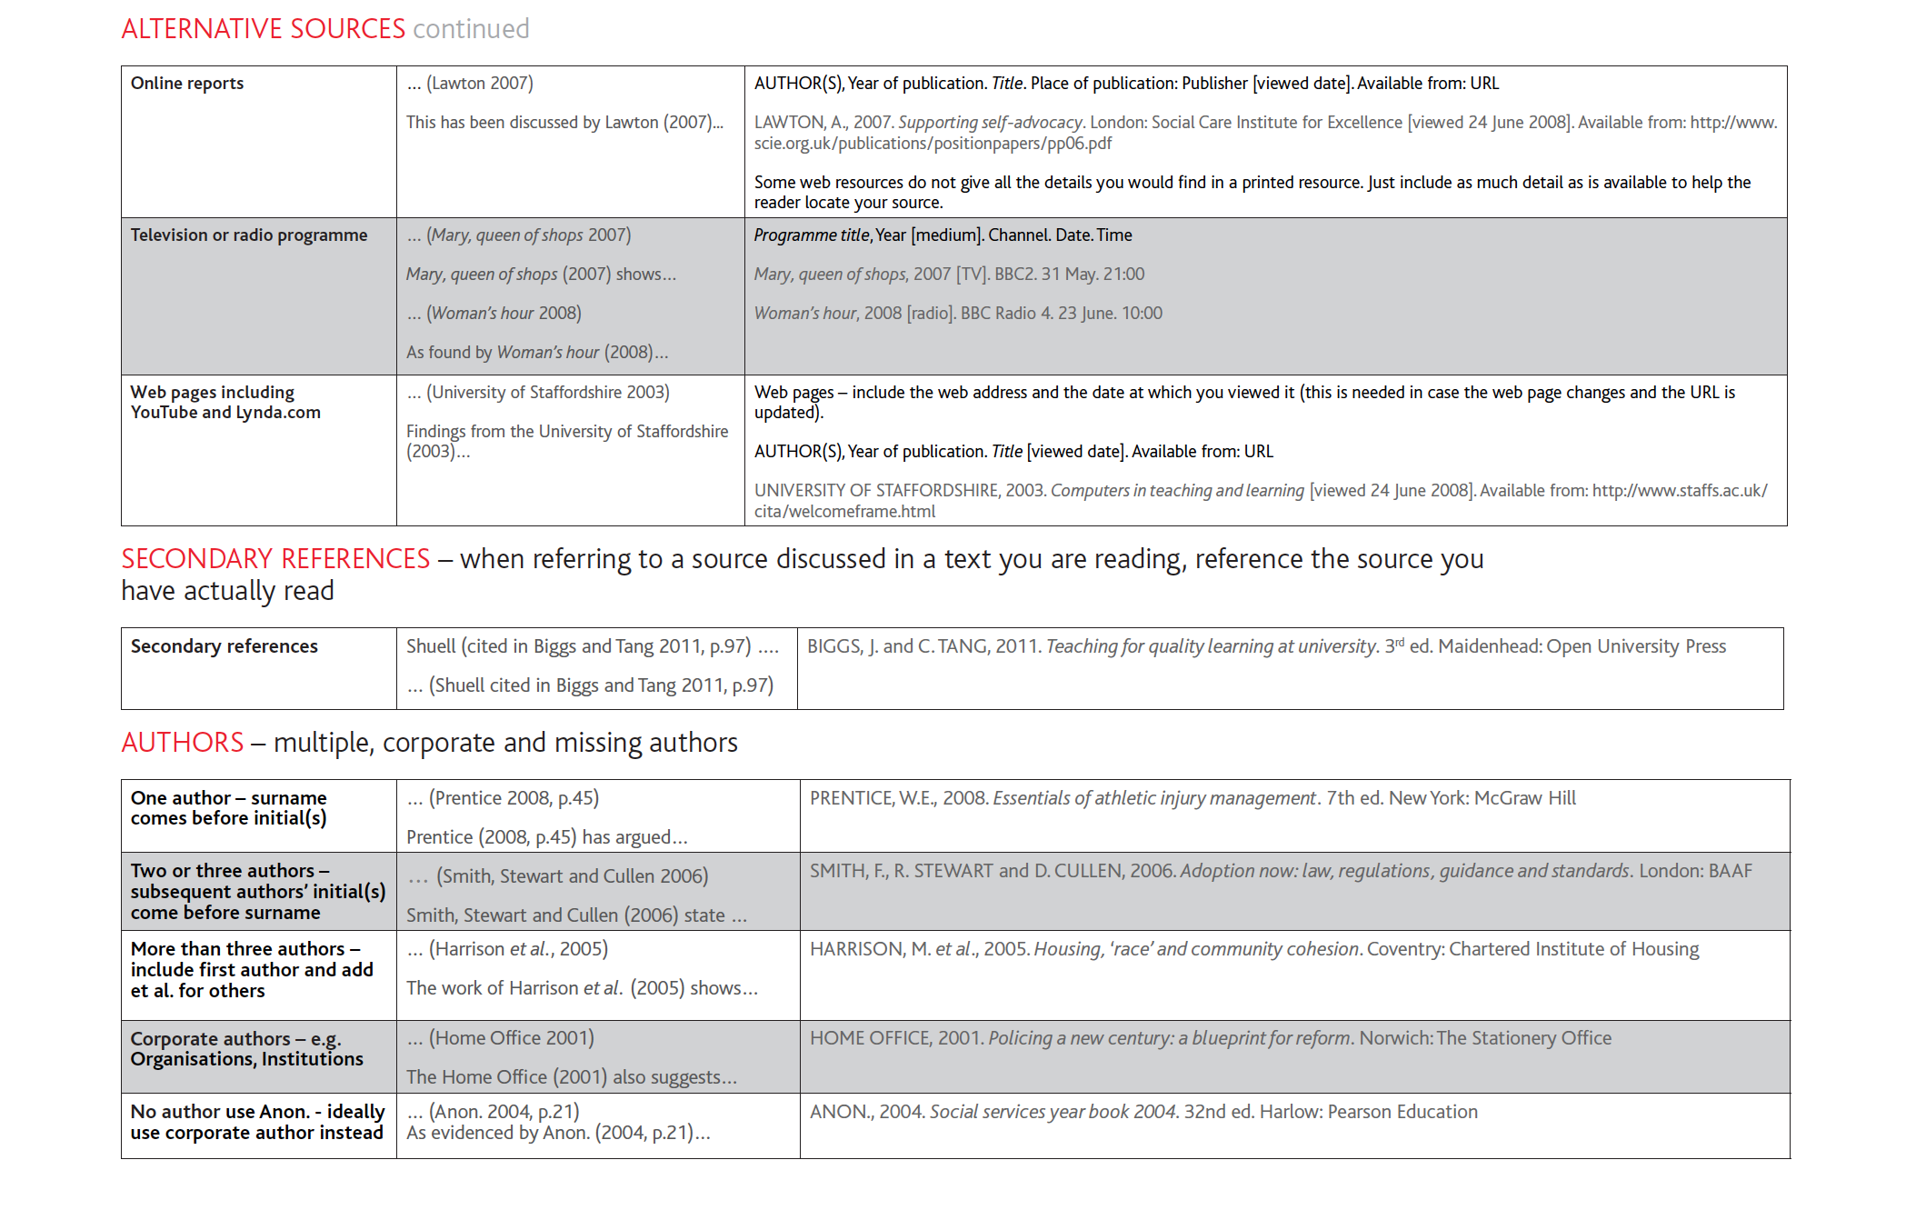

Slide 71
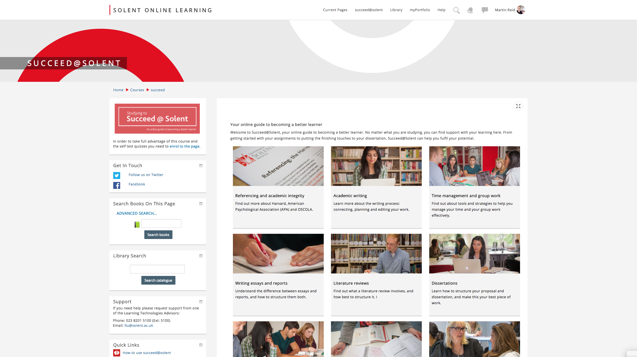
https://learn.solent.ac.uk/course/view.php?id=90

Slide 72
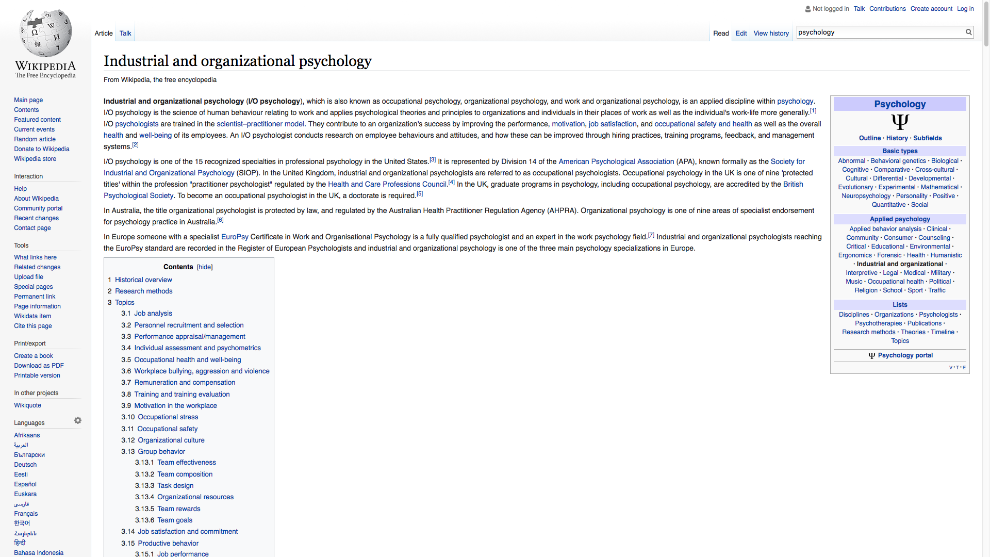
Notes:
Do not reference to wikipedia
https://en.wikipedia.org/wiki/Industrial_and_organizational_psychology

Slide 73
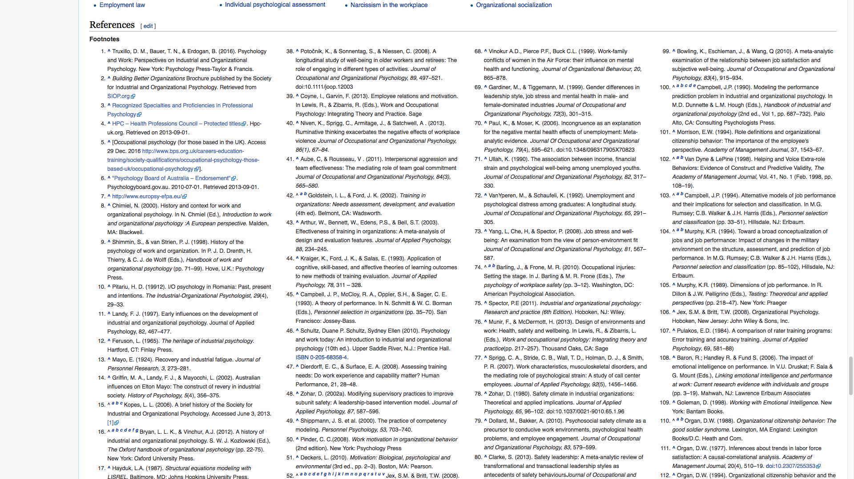
Notes:
But use the references to find original sources and references to them
https://en.wikipedia.org/wiki/Industrial_and_organizational_psychology

Slide 74
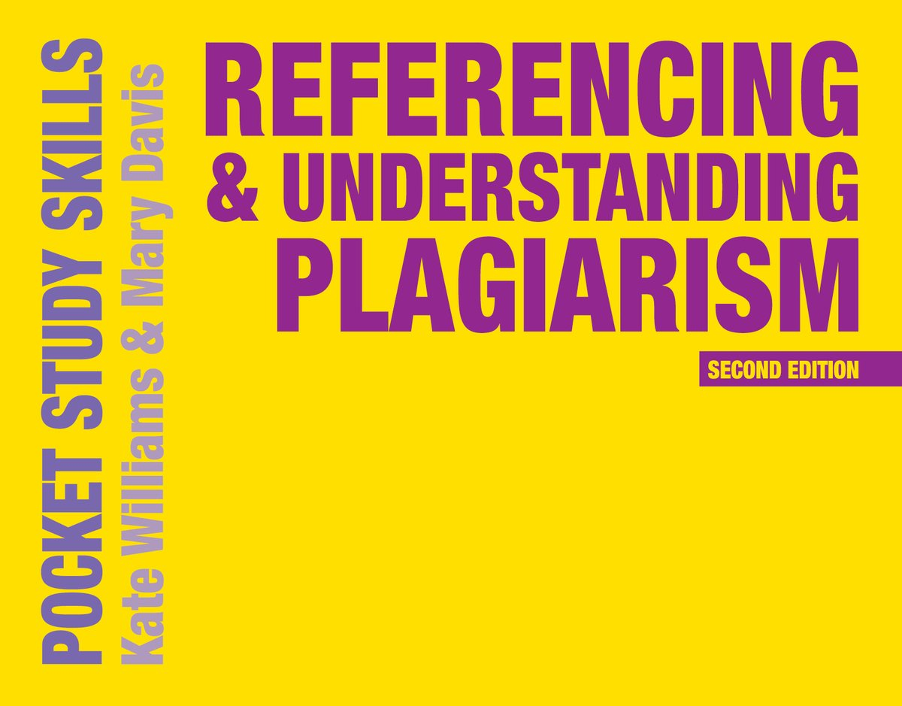
https://www.amazon.co.uk/Referencing-Understanding-Plagiarism-Pocket-Skills/dp/0230574793

